Slide 1

Classification Model: Predicting Physical Activities with features in fitness trackers

Slide 2

Overview
Introduction
Why I chose this dataset
Initial hypothesis
Data Exploration
Initial discovery and frequency distributions
Data Refinement
Feature correlations
Identification and handling outliers
Modeling and Testing
Building models
Comparison between models
Evaluation metrics
Key Insights
Conclusion

Slide 3
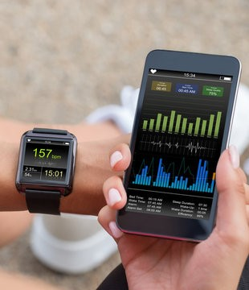
Introduction

Slide 4
Motivation and hypothesis
Project Motivation: Aim to design and implement a custom wearable watch using my embedded systems background and compare its results with existing wearable watch data.
Data Analysis of Fitness Trackers Benefits: Analyze wearable watch data to predict cardiovascular disease, stress, and sleep patterns.
Hypothesis: Heart rate and other cardiac parameters can accurately predict physical activity types.
Rationale: Physical activity increases the demand for oxygen and nutrients in muscles, elevating heart rate to meet the body's increased oxygen requirements.

Slide 5
Data Exploration
Closer look at the dataset

Slide 6
Dataset Overview
Column Names: X1, age, gender, height, weight, steps, hear_rate, calories, distance, entropy_heart, entropy_setps, resting_heart, corr_heart_steps, norm_heart, intensity_Karvonen, sd_norm_heart, steps_times_distance, device, activity
Dataset Explanation:
Corrected spelling of column names
No missing or duplicate values
Analyzed summary statistics
Frequency distribution of activities to observe class imbalance
Gender represented by 0 and 1, identified through statistical analysis and plots

Slide 7
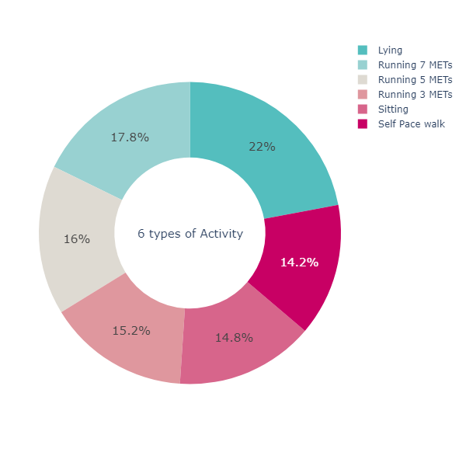
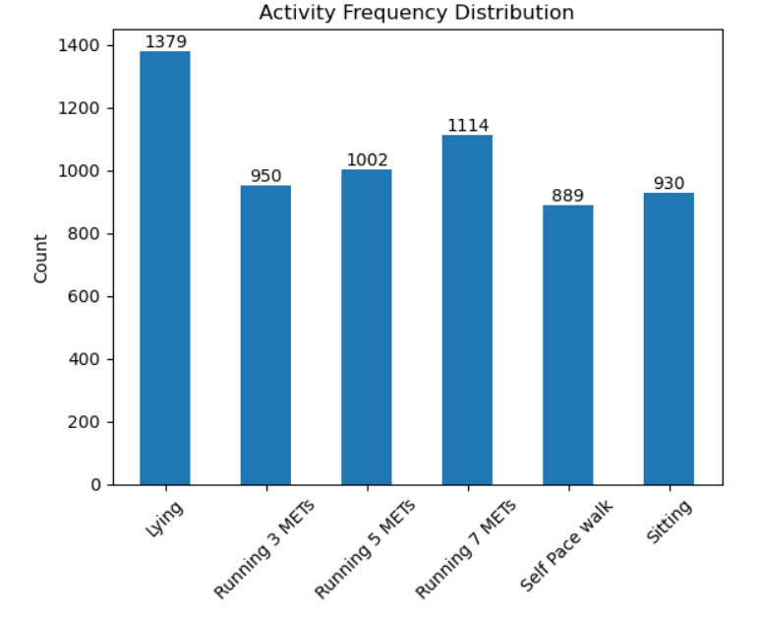
Activity Distribution

Slide 8
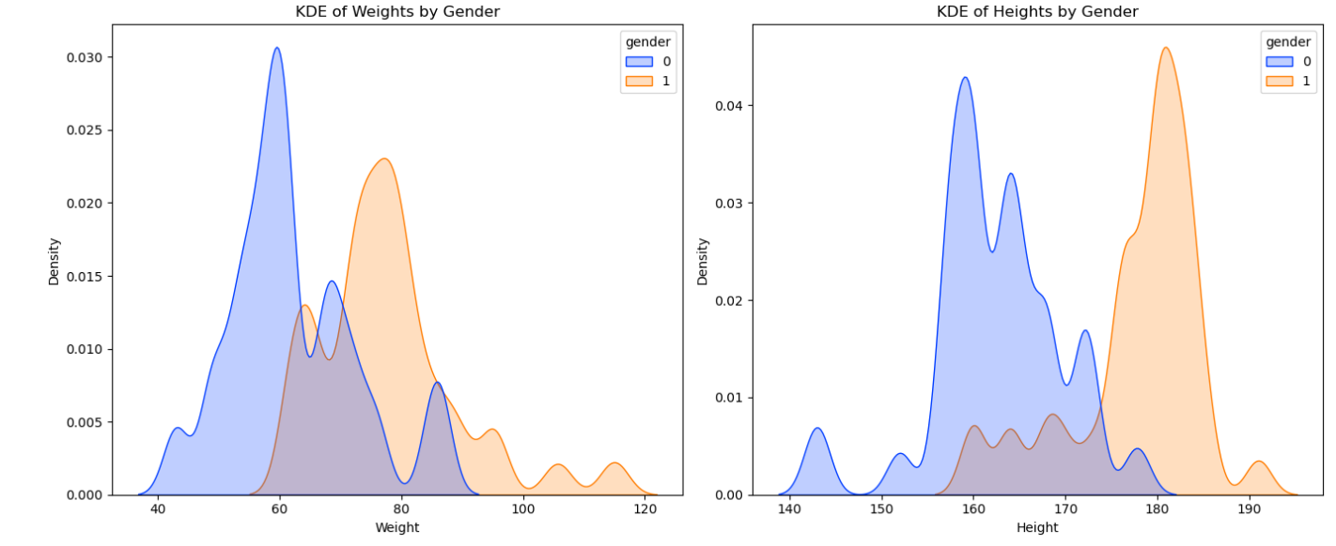
Gender KDE plots

Slide 9
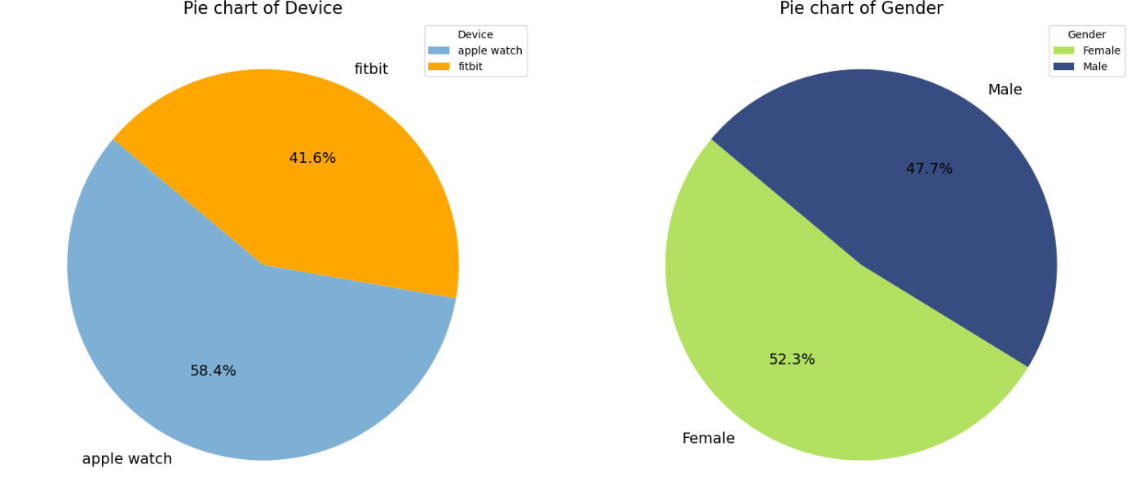

Slide 10
Key Findings
Heart rate values ranged from abnormally low (2.222 bpm) to high (194 bpm)
Activity "Lying" had a noticeable class imbalance (Managed class imbalance using SMOTE during modeling)
Gender identification: 0 is Female (lower mean height and weight)
Device distribution: Slightly fewer FitBit data points compared to Apple Watch
Age distribution: Mostly individuals aged 18 to 40
Numerical features: Steps, calories, and distance distributions are highly skewed

Slide 11
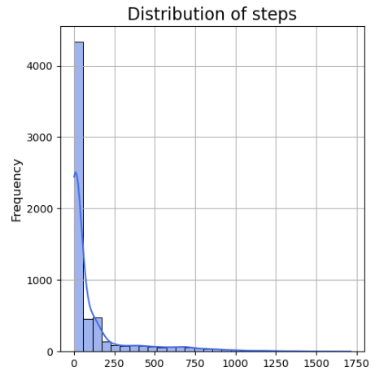
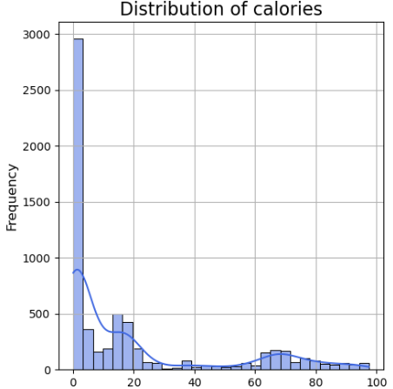
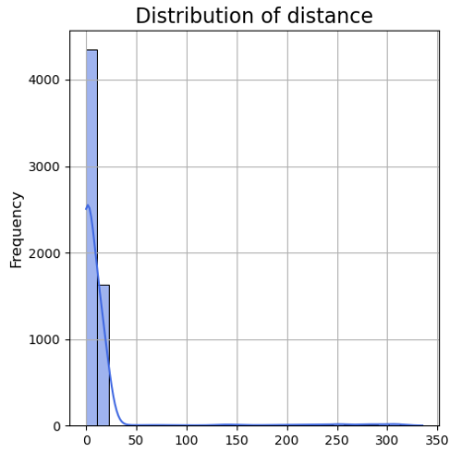
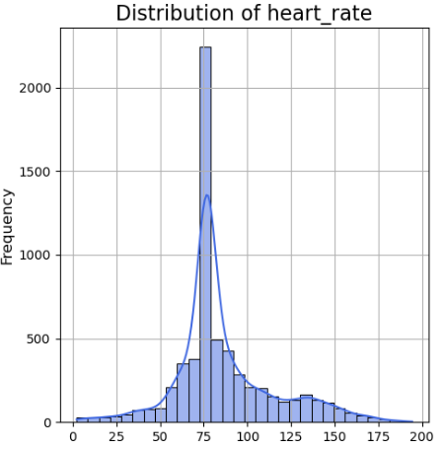

Slide 12
Data Refinement
Cleaning and preparing the dataset

Slide 13
Encoding and Correlation Analysis
Target Variable Encoding:
Converted activity to numerical format using LabelEncoder
Correlation Analysis:
Plotted a correlation heatmap to find related features
Notable correlations found between:
Norm_heart and Intensity_Karvonen
Steps and heart rate
Steps and Calories
Entropy of steps and Entropy of heart rate
Heart rate and Intensity_Karvonen
Calories and Steps
Distance and Norm_heart
Distance and Intensity

Slide 14
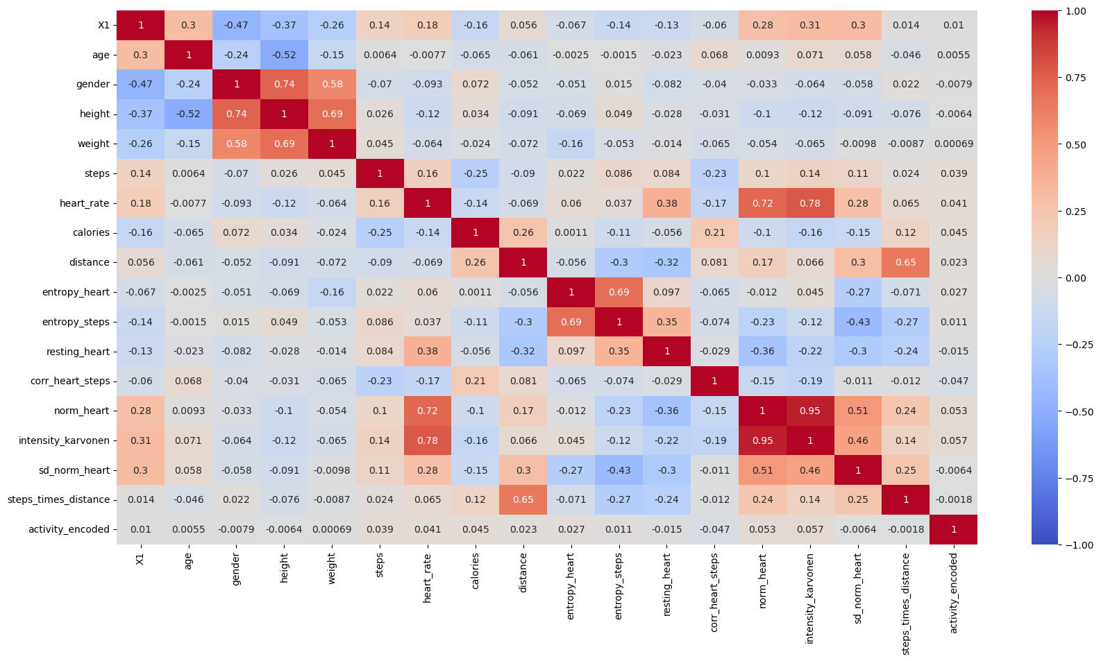

Slide 15
Feature Selection
Feature Selection:
Selected features for modeling:
Steps
Heart_rate
Calories
Distance
Entropy_heart
Entropy_steps
Norm_heart
Intensity_Karvonen

Slide 16
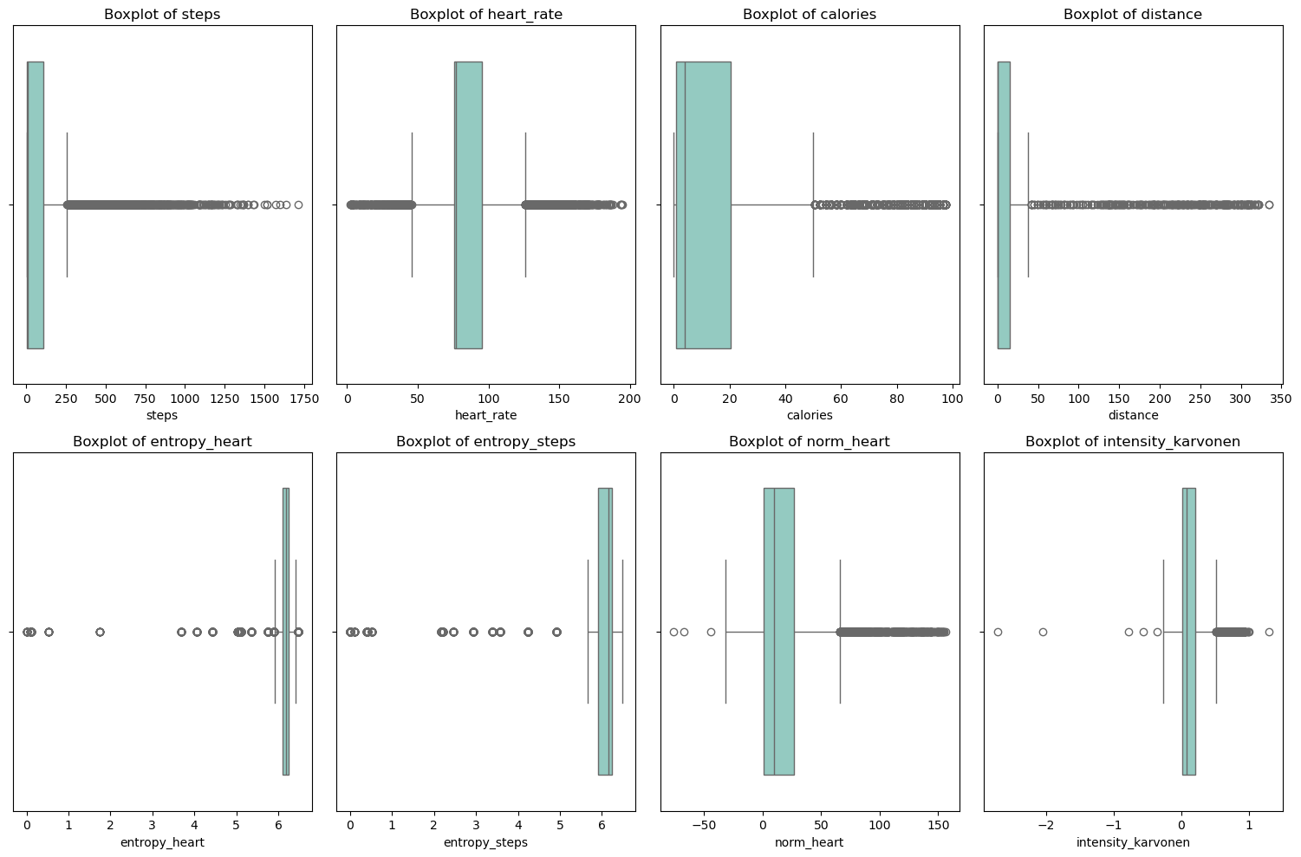

Slide 17
Outlier Analysis
Z-score with all numerical features
Z-score with selected features
IQR method
Original data shape: (6264, 20)
Data shape after removing outliers: (5239, 20)
Original data shape: (6264, 20)
Data shape after removing outliers: (5526, 20)
Original data shape: (6264, 20)
Data shape after removing outliers: (2723, 20)

Slide 18
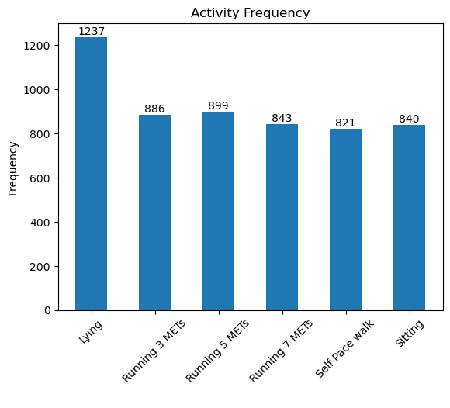

Slide 19
Modeling and Evaluation
Building the model and model advancement

Slide 20
Methodology
Feature – Target split
For selected and all features split into X and y
Train – Test split
For both the sets divided into 80-20%
Build the model
DecisionTree Classifier
RandomForest
XGBoost
Evaluation Metrics
Accuracy score
Classification Report
Confusion Matrix

Slide 21
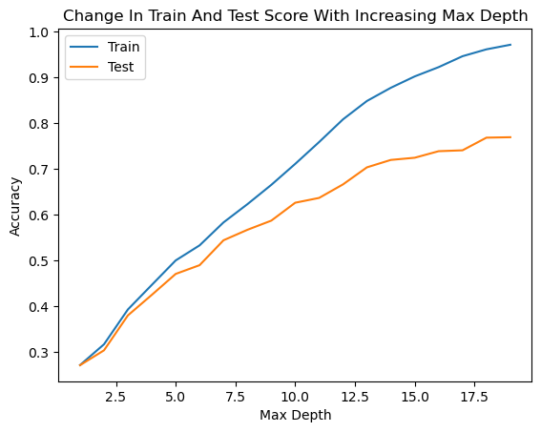
DecisionTreeClassifier Model

Slide 22
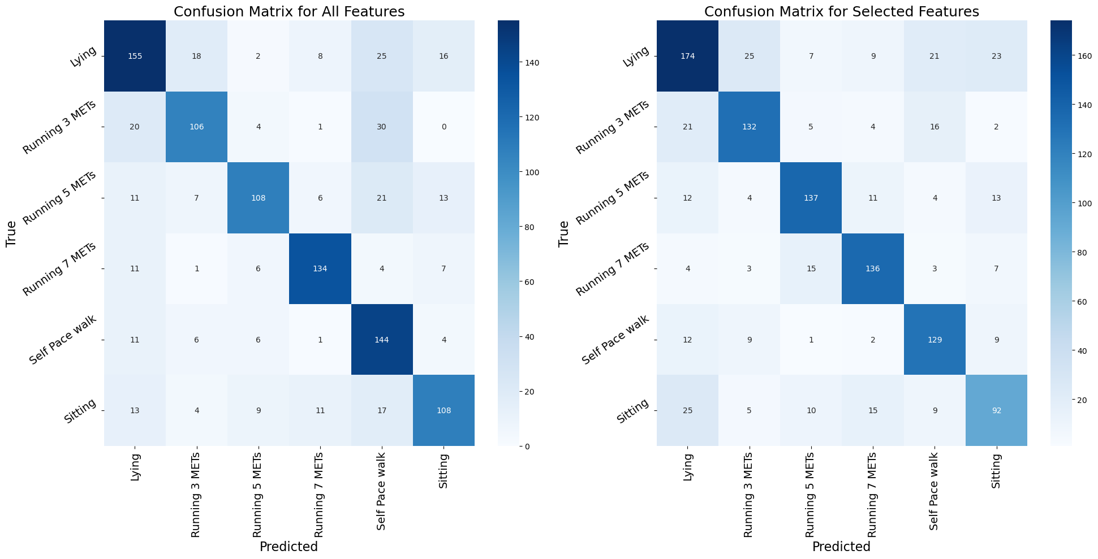
Comparison between all and selected features
All numerical features
Selected features
Accuracy Score with all features: 0.72041
Accuracy Score with selected features: 0.72332

Slide 23
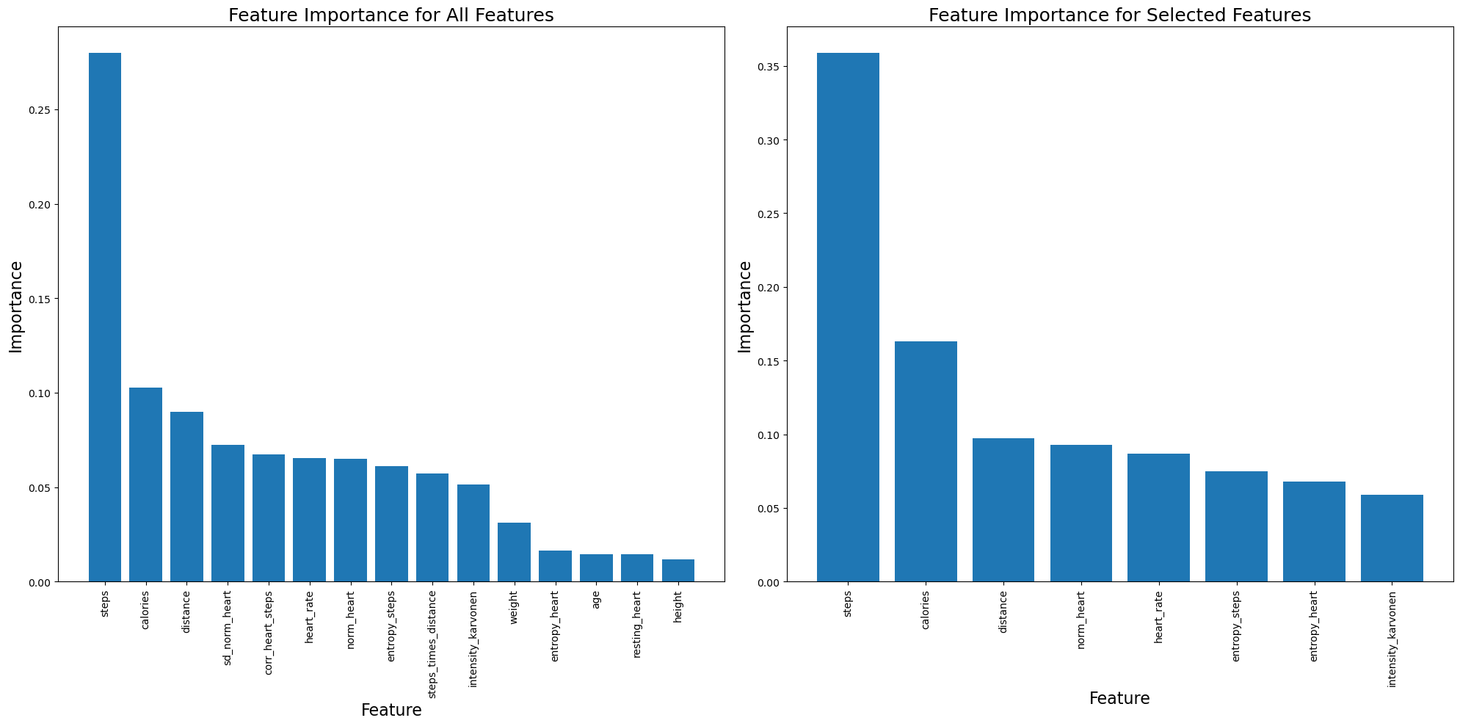
DecisionTreeClassifier Model

Slide 24
RandomForest and XGBoost Model
Random Forest Model
XGBoost Model
Initial Accuracy Score: 0.83182
After SMOTE, Feature Scaling and Hyperparameter tuning with GridSearchCV, Accuracy Score: 0.83544
After SMOTE, Feature Scaling and Hyperparameter tuning with GridSearchCV, Accuracy Score: 0.84719
After SMOTE, Feature Scaling and Hyperparameter tuning with RandomisedSearchCV, Accuracy Score: 0.84177

Slide 25
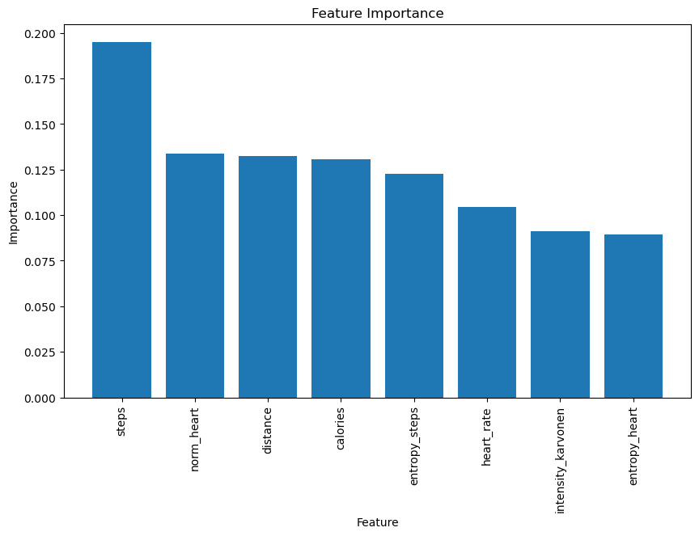

Slide 26
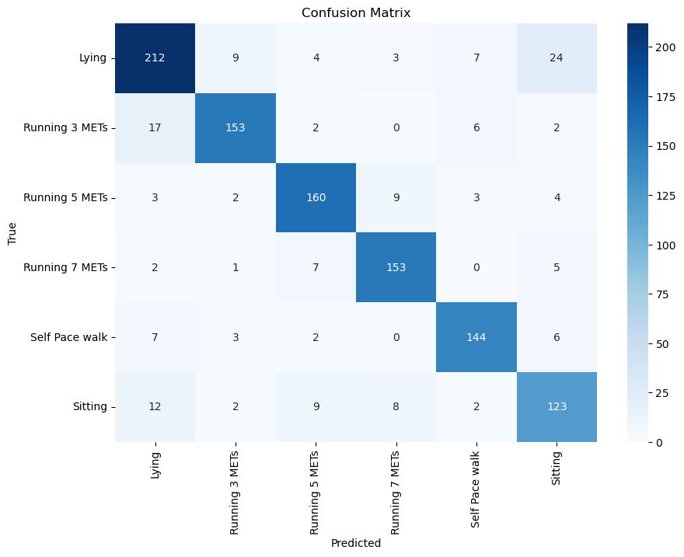
Combining both the Models
VotingClassifier
For better performance, both RandomForest and XGBoost is combined with VotingClassifier Model
Accuracy Score: 0.8544

Slide 27
Key Insights
XGBoost Model Performance: XGBoost achieved the highest individual accuracy among all models tested.
Ensemble Model Performance: Combining Random Forest and XGBoost in an ensemble model resulted in the highest overall accuracy.
Feature Importance: Steps emerged as the most important feature for predicting physical activity type, contrary to the initial hypothesis focusing on heart rate.
Steps as a Key Indicator:
Direct Indicator of Movement
Activity Intensity
Consistency Across Activities
Ease of Measurement

Slide 28
Conclusion
Direct Measure of Movement: Steps are a direct measure of movement and consistently correlate with various physical activities.
Heart Rate Variability: While heart rate is important, it can be influenced by numerous factors (e.g., stress, caffeine) and may not always clearly indicate activity type on its own.
Potential for New Features:
Steps-Heart Ratio: Combining steps and heart rate into a new feature could provide a more nuanced measure of physical activity.
Steps-Distance Ratio: Introducing the steps-distance ratio could further enhance model performance by capturing the relationship between movement and distance covered.

Slide 29

Thank You
Shriya Nithyan

